Slide 1
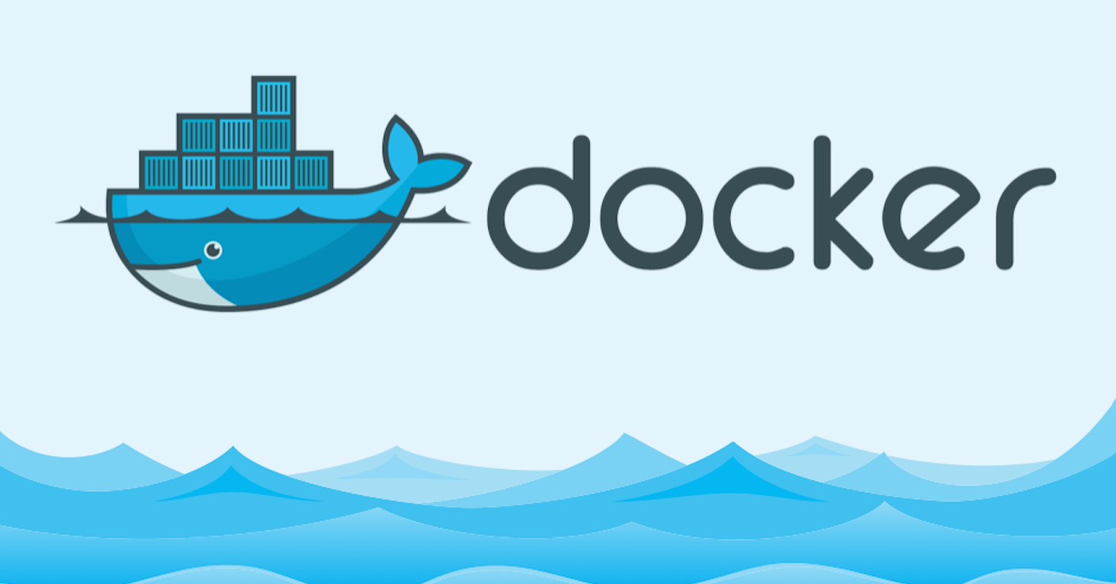
Introduction to Docker
The open platform to build, ship and run any application anywhere

Slide 2
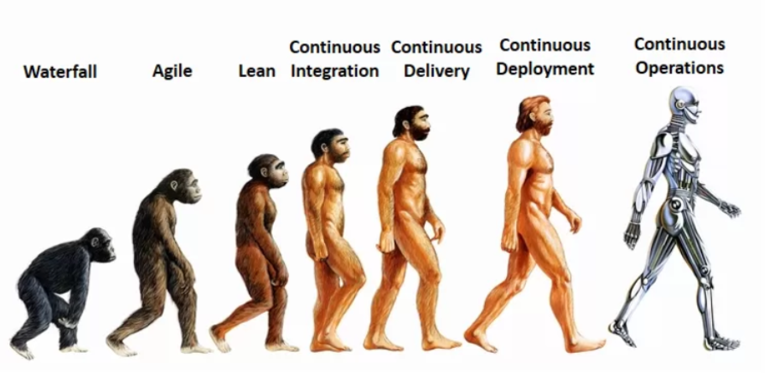
About me
14+ Engineering experience (Cisco Systems, VMware )
Continuous Operations buff and AWS enthusiast

Slide 3
Session Logistics
3 hours (exercising time included)
No docker experience required
You will need:
Linux machine
Dedicated
VM
Cloud provided
Enthusiasm
Familiar with basic Linux command line

Slide 4
Agenda
What is Docker
Containers vs Virtual Machines
Docker Platform Overview and Terminology
Docker Engine
Images
Containers
Registry
Repository
Docker Hub
Docker orchestration tools
Intro to Images
Getting Started with Containers

Slide 5
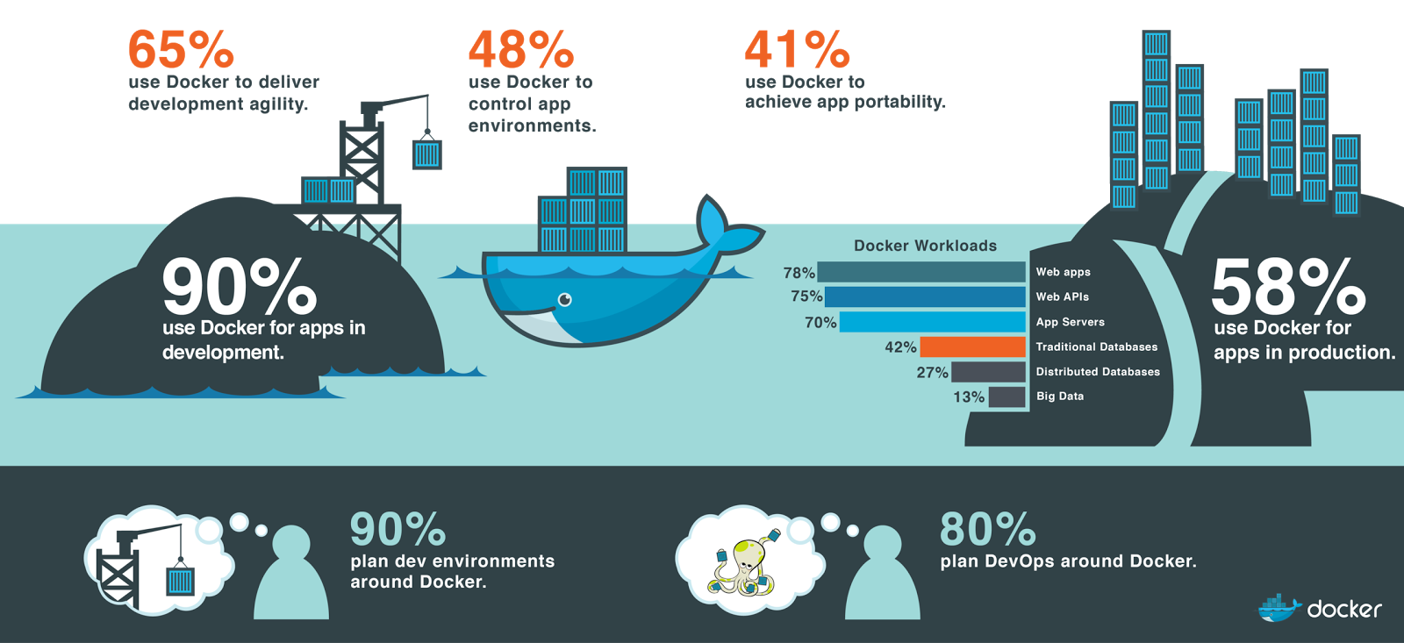
Docker community

Slide 6
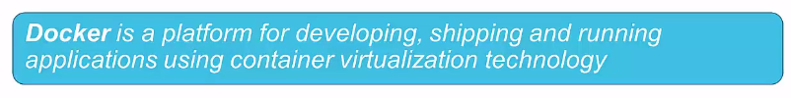
What is Docker
The Docker Platform consist of multiple products/tools
Docker Engine
Docker Hub
Docker Machine
Docker Swarm
Docker Compose
Kitematic (docker ui)

Slide 7
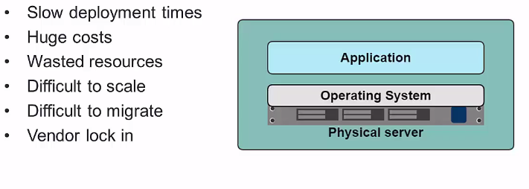
In the Dark Ages

Slide 8
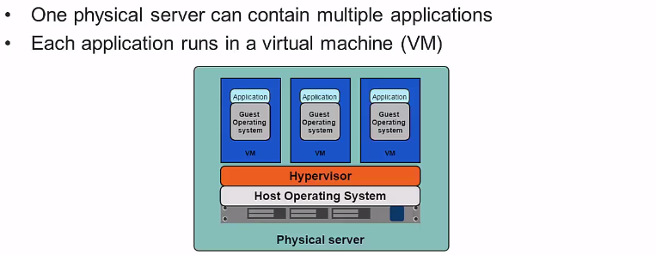
Hypervisor-based Virtualization

Slide 9
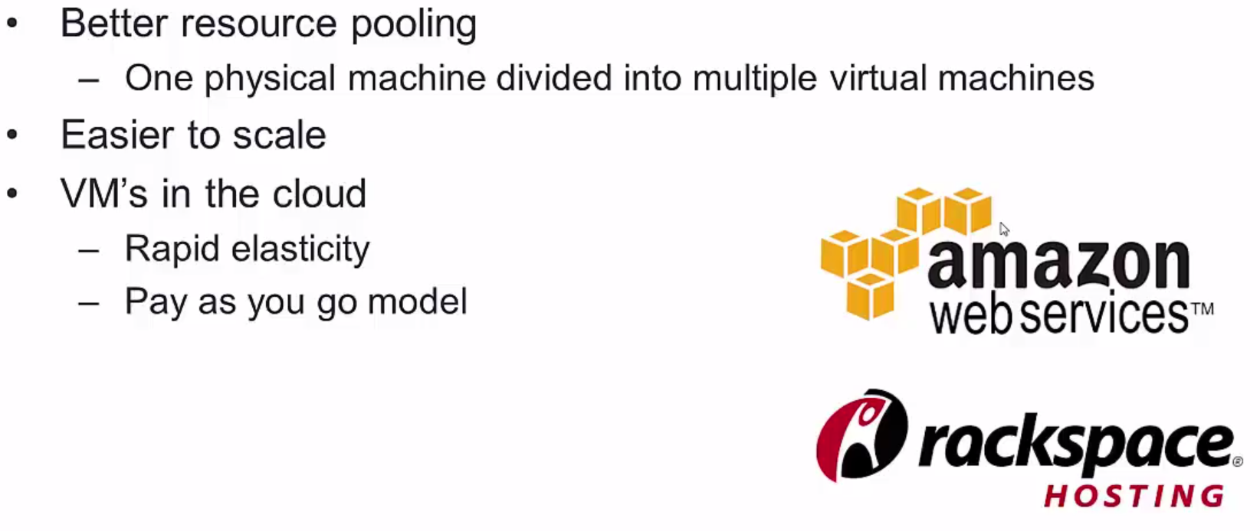
Benefits of VMs

Slide 10
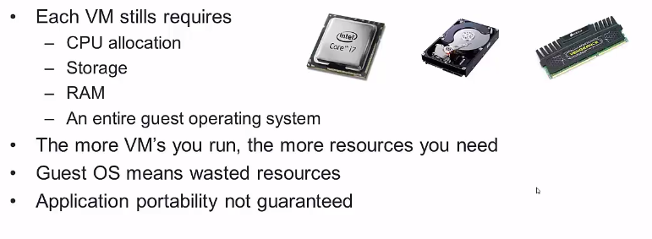
Limitations of VMs

Slide 11
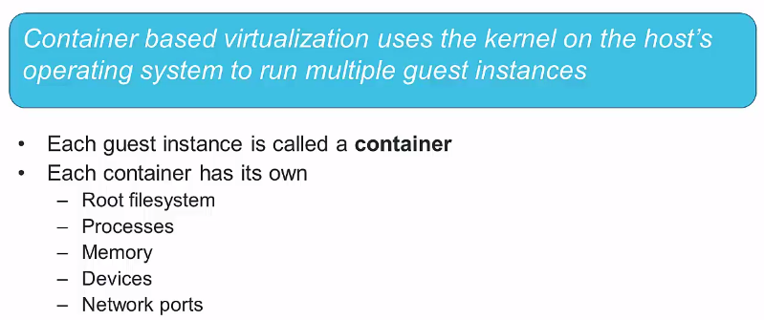
Introducing Containers

Slide 12
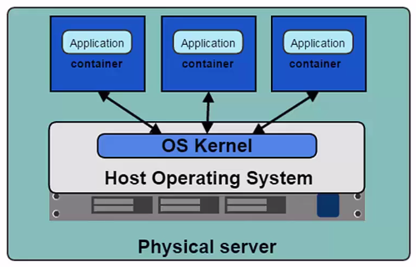
Containers

Slide 13
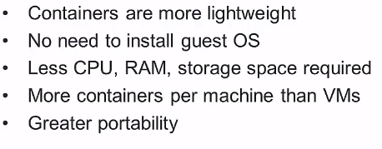
Containers vs VMs

Slide 14
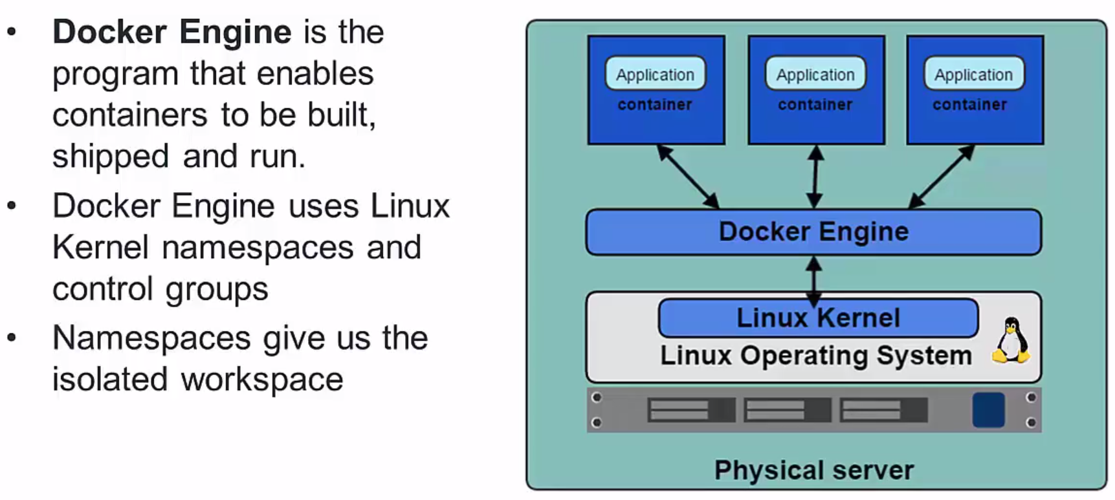
Docker Engine

Slide 15

Install Docker Engine
Install Docker Engine
Ubuntu
CentOS
Windows
Post install steps
Docker run hello-world
Hint:
Download putty
Enable sshd
sudo apt-get install ssh
sudo ufw allow 22
Enable NAT path to the VM
https://www.youtube.com/watch?v=oNK1fXhxQHs

Slide 16
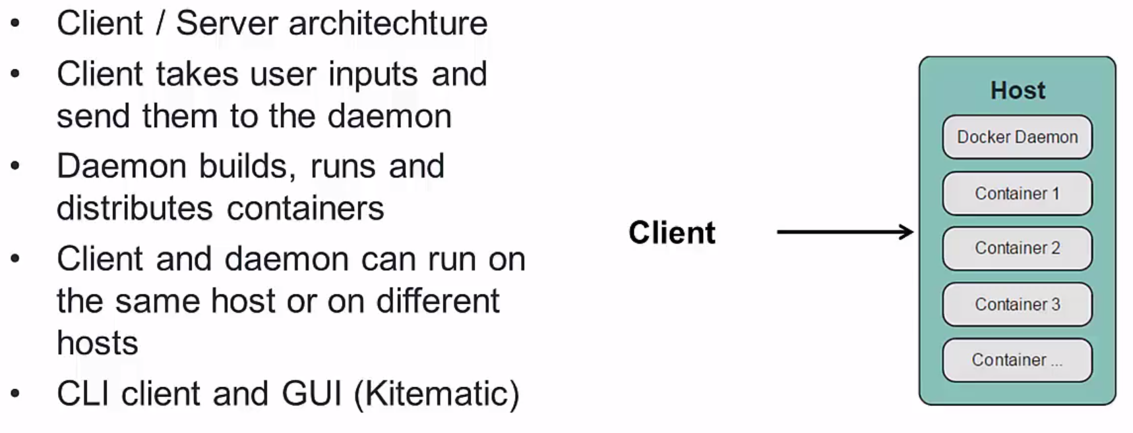
Docker Client and Daemon

Slide 17
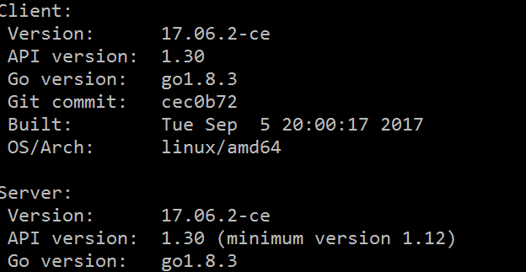
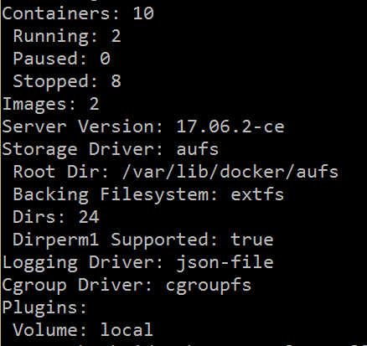
Checking Docker Client and Engine Version
Docker version
Docker info

Slide 18
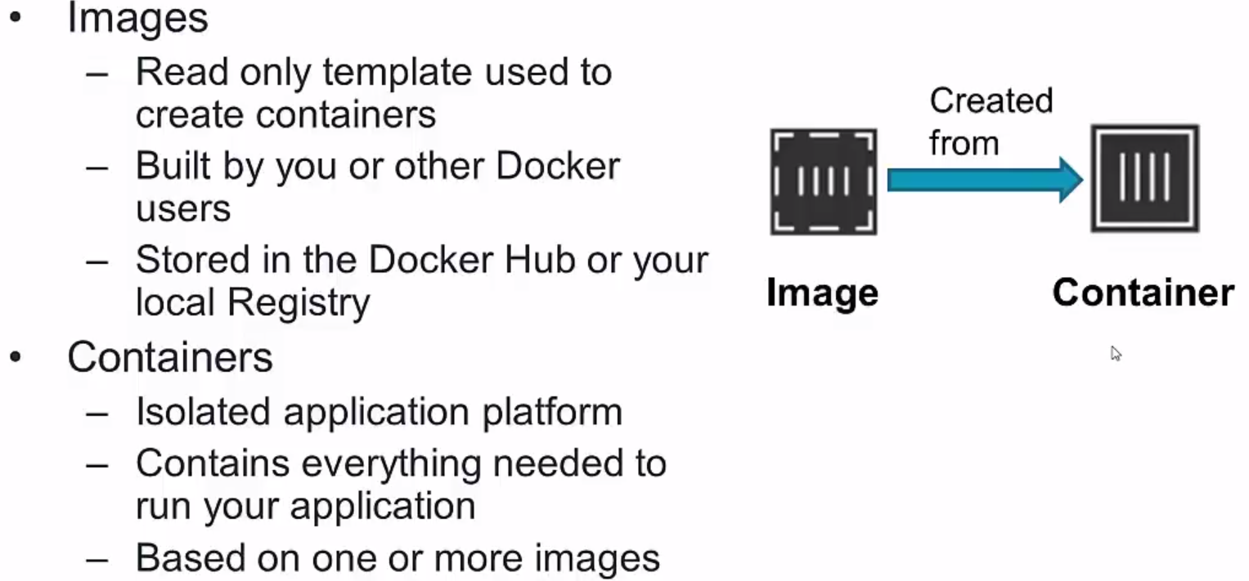
Docker Images and Containers

Slide 19
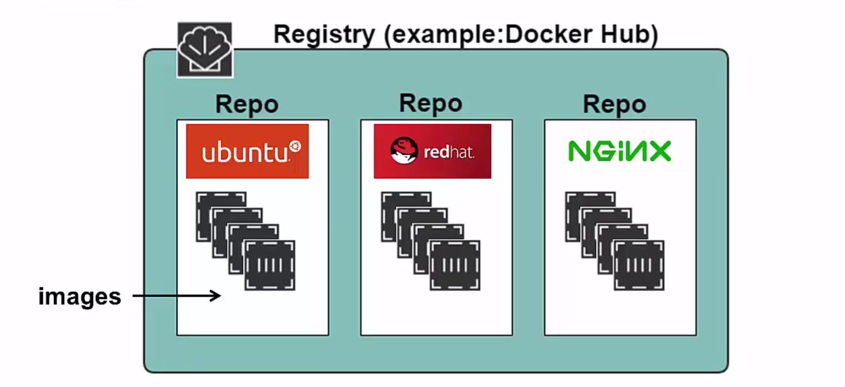
Registry and Repositories

Slide 20
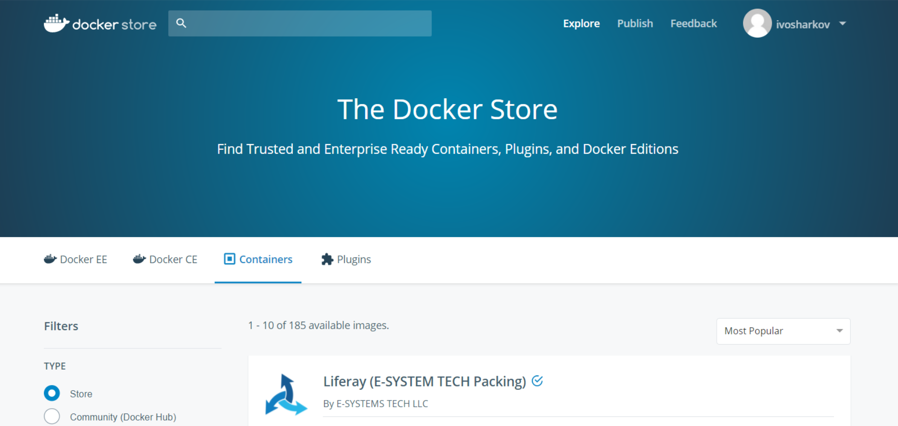
Docker Hub & Docker Store

Slide 21
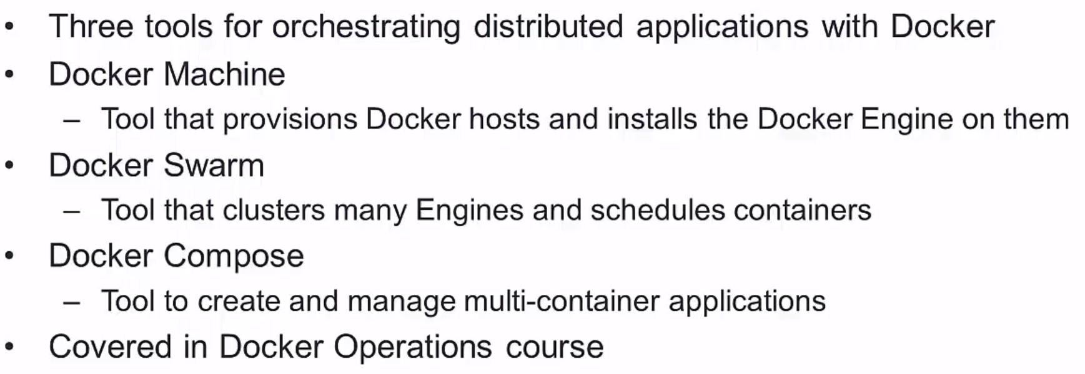
Docker Orchestration Tools

Slide 22
Docker Hub Walkthrough
Demo
Repositories
Dockerfiles
Tags
The Social part

Slide 23
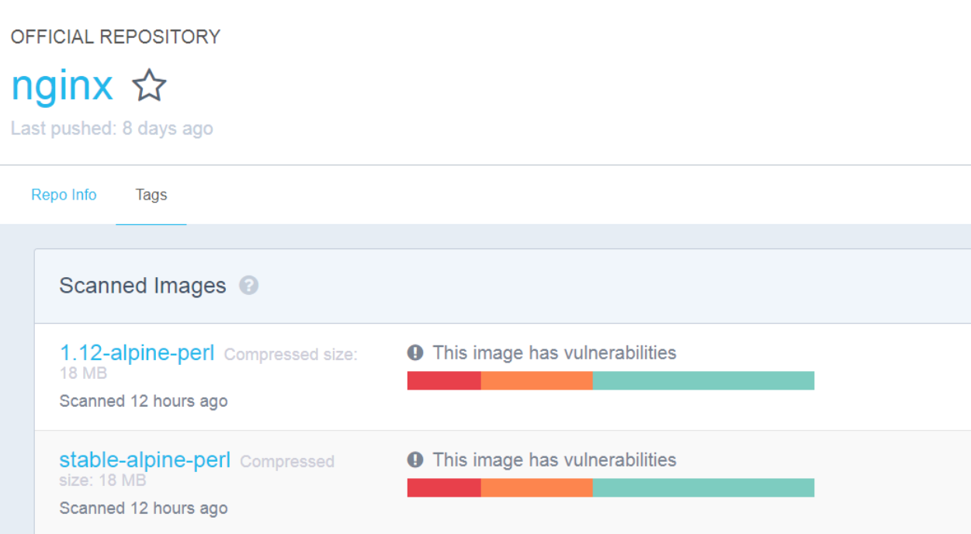
Image Tags
Images are specified by repository: tag
The same image may have multiple tags
The default tag is latest
Available tags could be looked up at the repository (alpine,java,nginx)

Slide 24
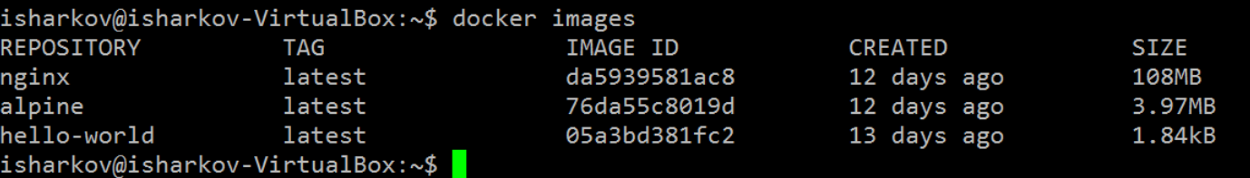
Display Local Images
Run docker images
Local and remote repos
docker run alpine
Do it again

Slide 25
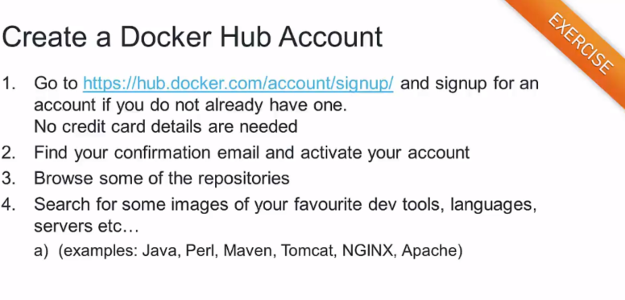

Slide 26
Creating a Container
Use docker run command
Syntax
docker run [options] [image_name] [commands] [args]
Image is specified by repository:tag
Type
docker run alpine echo “Hello World”

Slide 27
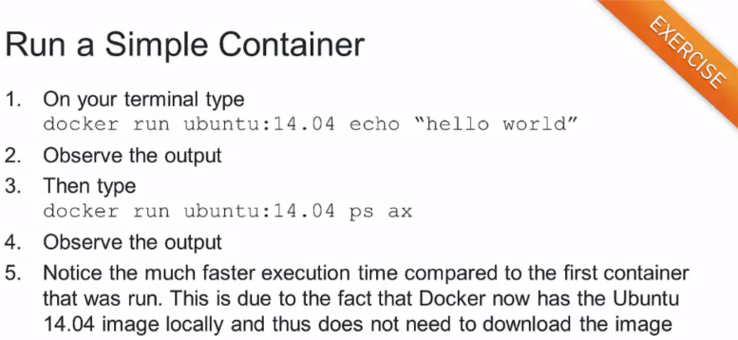

Slide 28
Container with Terminal
Container started with –i & -t
-I – interactive
-t – terminal
Demo
docker run –I –t nginx
docker run –d nginx
docker exec –I –t nginxId

Slide 29
Container ID
Container can be specified using their ID or name
Long and short ID
Short ID and name can be obtained with : docker ps
Long ID by: docker inspect [some_docker_container_name]

Slide 30
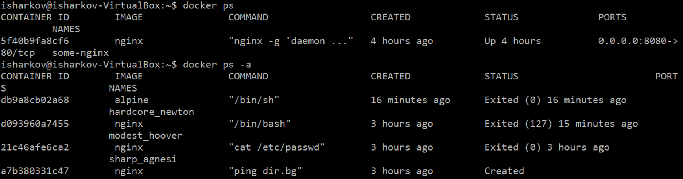
Find Your Containers
Use docker ps to list running containers
Use docker ps –a to list all containers (recently stopped are included)

Slide 31
Running in Detached Mode
Known as running in the background or as a daemon
Use –d flag
Where is the output ? (hint use docker logs (-f) container_id)
Example
docker run –d nginx ping dir.bg
docker logs –f nginx_id

Slide 32
Port Mapping
How to interact with myApp
-P for port mapping
docker run -d -p 8080:80 nginx

Slide 33
Docker most used commands
Docker images shows all images
docker ps shows running containers.
docker logs gets logs from
docker inspect looks at all the info on a container (including IP address).
docker events gets events from container.
docker port shows public facing port of container.
docker top shows running processes in container.
docker stats shows containers' resource usage statistics.
docker diff shows changed files in the container's FS.

Slide 34
Benefits of Docker
Separation of concerns
Developers focus on building apps
QA focus on testing
System admins focus on deployment
Fast development cycle
Application portability and
Build in one environment, test and ship to another
Scalability spin-up new container if needed
Easily spin-up new container on demand
Cost efficiency

Slide 35

Clean-up
Containers
docker rm
docker rmi $(docker ps -a –q)
Images
docker rmi
docker rmi $(docker images -q --filter "dangling=true")
Volumes
docker volumes rm
docker volume rm $(docker volume ls -qf dangling=true)

Slide 36
References
Docker cheat sheet
https://github.com/eon01/DockerCheatSheet
Create a best Image
https://docs.docker.com/engine/userguide/eng-image/baseimages/
Docker FAQs
https://docker-curriculum.com/
Google ☺

